Slide 1
Nortcele Systems
Date : Sept,2023
Version : 3.0

Slide 2
Contents
Executive Summary
Industry Focus areas
Embedded SW Offerings
BSP,Device Drivers & Firmware
Devices & Platform Design Services
Processors/Peripherals - Hardware
Hardware Design
Casestudies

Slide 3
Executive Summary
Founded in 2020
India, Bangalore
25+ Employees
11 Clients
To Engage with mid size or start-ups companies and augment their team to bridge skill gaps to realize their goal economically and timely.
The Terms ‘Fail Fast’, ‘Fail Often’ and ‘ Fail Better’ are quite applicable in the context of start-ups.
Nortcele endeavors to transform these slogans to ‘Succeed Fast’, ‘Succeed Better’ and Succeed Often’.
Our team consists of veterans in the field of tech with decades of experience in building products related to Embedded Systems, Telecommunication, Data communication., Storage and Automotive,.
It has been observed that hiring experts(SMEs) is difficult to afford for a start-up. Our aim is to provide an economical solution to bridge this gap in technical expertise.
Nortcele aims to help start-ups that are engaged in building hardware and software products.
We have expertise in realizing products from ideation, prototyping to productization.
We understand the constraints one faces during the bootstrapping of a start-up companies.
We are your real partners
Silicon Design Services
Board Design & Board Bring up
FPGA, Emulation & DSP
Embedded Design Services
Firmware, BSP, Boot Loader, wireless Mobile device, IoT devices, Device Drivers, Platform Dev Android /Linux/ Windows Application Development/Testing
Full Stack Development
UI/UX, Mobile App Development (iOS & Android)

Slide 4
What We Do - Nortcele
Full Stack Dev
Ui/UX,
Mobile App Dev (iOS & Android App)
IoT Device,
Automation
Firmware, Security Cloud Interface
Mobile Devices
-3GPP
- SDK, NDK, Drivers & Phone development,GCF,PTCRB & other certifications
Connectivity
BT/BLE–Profile development, Host Stack Integration & Testing
WLAN – Host bring up & testing.
LBS support
Storage
Protocols(SATA,NVMe & UFS).Feature enhancement, Automation testing
Embedded System & Software
Product (RE)Engineering
Verification & Validation

Slide 5
S/W Expertise -Embedded System, Protocol Stack, Peripherals & Storage
Protocol Stack Dev
Host and Control S/W development
Compliance Testing
Driver Development –Windows/Linux/Bare Metal Driver.
Tools – Automation Tools.
Board Bring up
Verification and Validation – End to end
BTLE
WiFi
NFC
Dash 7
Modem
GPS
Audio
Display
Camera
Touch
Keypad
Mic
SD
eMMC
SSD
Flash Memory
UFS/NVMe/SATA
AHB/APB/AXI
SDIO/SPI/I2C
USB/UART/Ethernet
PCIe
CAN/LIN/Flexray
Contact
Non Contact
Wireless
IOs
Storages
BUS & I/F
Sensors
Tools,Languages & Procs
Lauterbach/Trace32,Green Hills,LA & GDB
Processors - Micro controllers – Arm7TDMI, ARM Cortex -M3/M4 , ARC, 8051, STM32Fx... , Freescale MPC512x
OS(RT) – FREE RTOS, Linux, QNX, Android.
FPGA based Emulation.
SoC (Qualcomm,Broadcom & TI) Programming Languages – C,C++ & Python

Slide 6
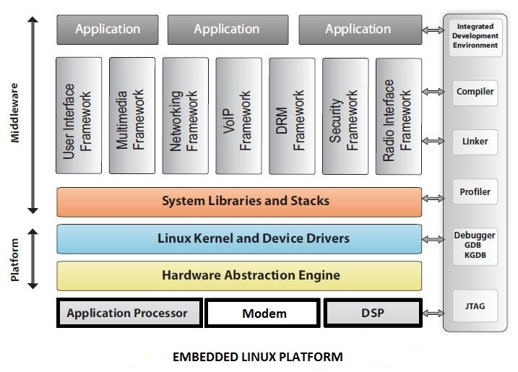
Platform Design Services - Nortcele
Platform Development & Maintenance
Enhancements & Porting Linux/Android to different hardware platforms
Media Framework & Open GL Integration
Customer Functionality development
System integration and release management
Platform Validation
System driven Individual component testing
System - Functional, Performance & Reliability testing
Field Testing & Interoperability testing
OEM/ODM certification testing
Test Automation and Test enhancement
Board Bring up & Diagnostics
Hardware bring-up
Soft boot up
Diagnostics test for board using Logic, Spectrum & Protocol Analyzer
Automated manufacturing test env.
BSP Porting
Boot loader development
OAL/HAL porting
Migration across BSP versions
Migration across processors and platforms
Driver Development
PCI Interface,
Ethernet, SPI, I2C, USB, CAN, SCI
IR, RS485, RS232, MMC/SD
Touch Panel, Video Display
Statically or Dynamically linked Drivers
Validation Services
Platform Validation
Compliance testing
Power and Performance testing
BSP Validation
Test cases execution – VTS/CTS
Execution of performance tests
Test report generation
Log new Bug
Driver Validation
Independent Driver validation
Integrated driver subsystem validation
System validation
Reliability and Performance validation
We have expertise in building Android Based device

Slide 7
Device Expertise – Android
Android Based Device and Platform
Board Bring Up for Android Based devices such as Smartphone and Tablets
Any device or peripheral integration expertise such WiFi/BT/BLE/GPS/Modem or any custom device
JNI-NDK
Android HAL .
Feature bring up & Peripheral integration.
Power Optimization
HAL for all Audio, Video, Peripheral Etc
Android Applications,
Android System Services/App
Strong debugging knowledge, C/C++/java/kotlin
CTS/VTS and Certification

Slide 8
Hardware Expertise - Processor
Processor/SoCs/SoMs/MPs
FPGAs - ZCU 102 and ZC 706
SoCs - SDM/APQ,
SoMs – i.MX6/8,ESP32 & ESP8266
Processors – ARM & RISC V
RISC V
Board Bring Up and System Bring up - Linux
Optimizations – Kernel and boot up
Adding power management feature.
Secure Boot enabling for RISC V over Linux
Kernel optimization skills.
Framework migration - QT framework,Vilkan
Graphics framework /Audio frame
Tensor flow migration
New board low level drivers

Slide 9
Hardware Skills - Nortcele
Hardware expertise on multiple domains & protocols.
S# | Domains | Protocols/Buses | Comments
1 | Networking | Gigabit Ethernet,
2 | Wireless & Cellular | BT/BTLE,JESD 207, CPRI4.2
3 | Memory | NVMe
4 | Bus Protocols | PCIe,USB 2.0,AXI 3.0, AXI 4.0, AHB,APB | USB 2.0,I3C I2C,I2S,UART SPI

Slide 10
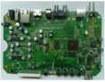
Mobile Device Development – OEM & Chipset Vendor Support
A TYPICAL VALUE CHAIN – MOBILE DEVICE DEVELOPMENT
ES
EVAL - Commercial Quality standard
OEM Productization
Phase
Operator
Acceptance
MR
Chipset
VENDOR
OEM & Chipset
Joint Effort
OEM Drives&
Chipset Vendor Supports
Operator
Compliance
& PROCESS
SALES
CHANNEL
Nortcele Systems Offerings
Device Definition
Chipset Evaluation & Selection
Peripheral selection
Hardware Integration
PCB Design/Board Design .
Board Bring Up
Peripheral S/W Integration.
Platform S/W Integration.
Custom BSP Development
Custom Device Integration
Platform Version Upgrade
Integration/Functional Testing
Pre-certification Test
Stress & Robustness testing,KPIs & Operator compliances
Android/Linux/Windows/RTOS/Any proprietary Platforms

Slide 11
How Do We Work - Engagement Model
FPP
Fixed Price Projects with Complete ownership of Module up to system testing. Scope gets identified in proposal.
It starts with proposal & executed with complete transparency. milestone based billing.
ODC
An ODC (Off short Development Centre) of 5-10 members can be hosted with Project Manager
Experienced in assessment of risks & mitigation, resource loading & utilization. Billing is always TnM in this model. Team will be pyramid structured.
RA
In RA (Resource Augmentation) Resources from Nortcele gets deployed on client project with right skills.
Engineers quickly adopt to client processes & follow instruction from managers. Billing is again T&M

Slide 12
Engagement Flow- Nortcele
RFP
From client
Proposal
From Nortcele
Proposal Review by client
& rework
Acceptance & signoff from both parties
Nortcele Proposal will have following information
Product overview and system details.
Creation of sub requirements from main requirements
Work Break down structure.
Schedule/reporting
SPOC/Meeting details
Resource Requirement
Milestone based payment schedule
Risk/Assumption/Dependencies

Slide 13





Location #92, Ist Floor, Natraj building, Near SNS Arcade, Konnena , Old Airport Road, Bangalore 560017 www.nortcele.in Contacts
Contact us
Nortcele Systems
+91 9886422528
aks@nortcele.in
www.nortcele.in

Slide 14
Thanks

Slide 15
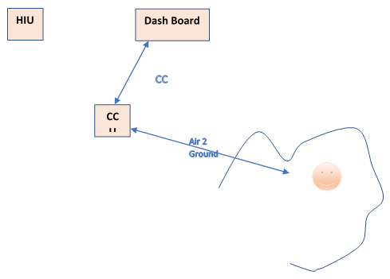
Case Study - Audio-Video & Communication Systems for Spaceship
Project Objective | Selection of Processors/Chipset for Spaceship A/V & Communication Systems
Project Details | Developing an Audio-Video processing system for space to ground communication
Technologies-Domain | Multi Media, Telecommunication, Wireless & Data communication
H/W & S/W | H/W: Communication Control Unit, Handheld Device, Micro Controllers (ARM based, power sensitive and rugged for enough for spaceships), SoC and XQ Zynq® UltraScale+™ MPSoCs
Team Size | As a Consultant
Location | India
Status | Completed
Client | Indirect

Slide 16
Case Study – Vehicle Tyres Pressure Monitoring Systems
Project Objective | Development of Firmware for Tyres Pressure Monitoring Device
Project Details | A Low cost device, which will be kept in Tyre to monitor the pressure, raising alarm if pressure drops below set threshold level. The Firmware was to be developed for same. Also provision was made to connect BLE
Technologies-Domain | Pressure Sensor, BLE, Power Management, Timer/Counter, Embedded Systems
H/W & S/W | H/W:Atmel ATtiny202/402 (Microchip),Nordic BLE. S/W : Atmel tool chain for SW development, C and Nordic Tool chain.
Team Size | As a Consultant
Location | India
Status | Completed
Client | A Japanese Semiconductor Company
MCU
Program Control Pin
GPIO
Sensor
ADC0
Output
PWM
GPIO
ADC1
UPID/RX/TX/VCC
GPIO
Switch
BAT
Program Port

Slide 17
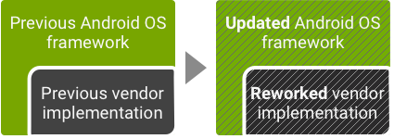
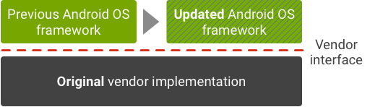
Case Study–Porting Android 7 To Android 9 for a Credential Identification Management Device.
Project Objective | Upgrading the Andriod7 Version to Android 9 for a Credential management .
Project Details | Upgrade the existing Bio Metric device (Based on iMX6 SoM) to comply with Android 9.00 or Android Pie release without degrading any of the existing functionality
Technologies-Domain | Bio Metric Sensor, BSP, Linux and BSP Porting and Android. System Applications interfacing with Cloud.
H/W & S/W | iMX6 SoM, 4G Modem,BLE/WiFi, BSP,GPS & Display Android 7/8,Linux 4.18,Codeaurora,u-boot
Team | 5 People
Location | India
Status | Completed
Client | An American Client-Leader in Identity management

Slide 18
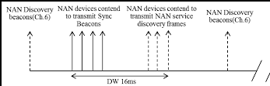
Case Study–WiFi Aware Chipset Integration
Project Objective | WiFi Aware Chipset Integration with Existing Android Device
Project Details | An Android device had got existing WiFi/BT module; it was to be replaced with module having WiFi aware capability. WiFi Aware is firmware and Host centric (mostly realized by Host). The functionality of firmware which supports RTT was extended to realize WiFi Aware feature. Needed WiFi Driver update
Technologies-Domain | WiFi, WiFi Aware
H/W & S/W | iMX6 SoM, 4G Modem,BLE/WiFi, BSP,GPS & Display, QCA6174A Android 7/8,Linux 4.18,Codeaurora,u-boot
Team | 2 People
Location | India
Status | Completed
Client | An American Client-Leader in Identity management

Slide 19




Case Study : Smart Overhead Tank Monitoring Solutions
Project Objective | To Build a Robust & Economical solution to Monitor overhead Tank Water
Project Details | -One can install mobile App to communicate with device, it is good enough for 3 floor building -It is a floating device in water so free from any installation. -Based on BLE communication so battery life goes up two years. -Feature can be extended to water consumption pattern
Technologies-Domain | BLE,ESP32.Sensor used is confidential
H/W & S/W | ESP 32, FreeRTOS, Android App
Team | 2 People
Location | India
Status | In productization phase
Client | Tank Supplier (B2B) and B2C (normal consumers)
Mobile App to Monitor
Water level

Slide 20
Case Study : High Precision Temperature/Pressure Sensor
Project Objective | Building of High precision Temperature/Pressure Monitoring device for Weather forecasting
Project Details | -This device is being built for one company involved in building weather sensing equipment -This sensor is based on BMP390 sensor so building a versatile driver was required. -Command Interpreter and 25 command implementation was required to make to communicate with Weather Station and computer was required. -It is highly power efficient with high availablity was required
Technologies-Domain | Embedded System, Weather Sensing and Sensor drivers
H/W & S/W | BMP390 Bosch sensor,ATSAM11L16E,RS485 etc was required
Team | 3 People
Location | India
Status | Complete
Client | A Leading weather sensing company based out of USA

Slide 21
Case Study : Full Stack/Mobile App/Websites and cloud based solution
Websites | Several dynamic web sites have been built and deployed
Web Apps | 3 Ecommerce, 1 real estate community management app,1 Web App for ship location management
Mobile App | More than 10 apps have been built and deployed
Systems | Community Management Software with Web and Mobile App

Slide 22
Case Study : U Boot modification to secure Kernel Image
Project Objective | U Boot Development – Securing Linux Kernel Binary at U Boot Level
Project Details | -Securing Kernel Image at U Boot level (during boot process). -While booting , U Boot will wait for challenge Key from remote station to authenticate the Linux Kernel. -After receiving challenge key, it will generate digest using BLAKE2S algorithm. -Digest Key will be pass ed HMI application to authenticate the Linux Kernel Binary
Technologies-Domain | U Boot, Toradex Apalis iMX 6 board, Carrier board, RPI3 Plus.Linux Kernel
H/W & S/W | iMX6,Toradex Apalis iMX6,U boot ,Toradex carrier board ,Display driver etc
Team | 3 People
Location | India
Status | Completed
Client | Defense organization

Slide 23
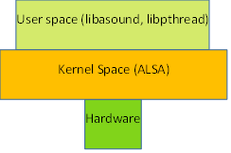
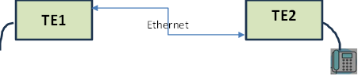
Case Study : PTT Phone Feature Enhancement
Project Objective | PTT Phone feature enhancement, transporting Voice data & control signal
Project Details
Technologies-Domain | ALSA Framework,Linux MultiMedia
H/W & S/W | Linux Application, Toradex Apalis T30 board, Carrier board, ALSA Framework,
Team | 2 People
Location | India
Status | Completed
Client | Defense organization
Objective is to develop the uplink and down link modules for proximity and remote modules respectively. Client has got Apalis T30 based Terminal Equipped (referred as TE) with Codec interfacing with wireless terminal device. Wireless Terminal device can be used for Push To Talk(referred as PTT Device) communication. PTT device has got all required interface (such as PTT signal, Analog signal to interface with MIC (equipped on PTT Device) or voice with TE. Requirement is to transport all the control and voice data to another TE and render it on port or codec at remote place. Connectivity between TEs are using ethernet to communicate with each other. Below is the pictorial representation of understanding of Nortcele Engineering Team.

Slide 24
Thanks For Your Time

